Slide 1
Plantish Analysis
By : John Morales

Slide 2
Table of contents
01
02
Data Cleaning
Top Products
03
04
Promo Effect
Customer Lifetime Value
Clean data for more accurate analysis
Analysis on top products
How do promos affect sales?
And ways to increase LTV.

Slide 3
Table of contents
05
06
Avg Total Order
Shipping locations
07
08
Inventory management
Average CAC
Average total order, how do promos affect it?
Most frequent shipping locations and ways to reduce shipping costs
How do we reduce damaging / losing goods?
Customer acquisition cost

Slide 4
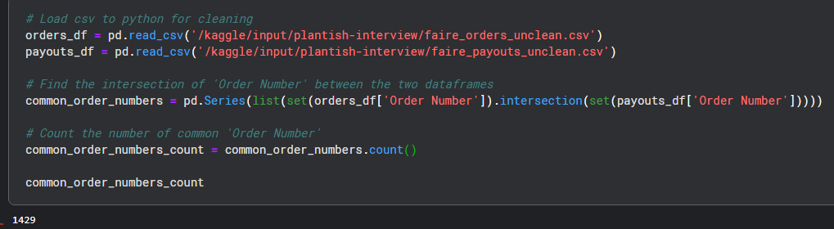
0
Data Exploration
From Data exploration, I noticed that there were 1429 common rows (Order numbers being equal) between the faire_payout and faire_orders dataset.
I want to merge the two fiels for ease of analysis. We must do an outer merge because of the common rows.

Slide 5
Data Cleaning
1
Delete the 8 duplicate rows, these rows could be due to collection error, skewing data.
To make data easier to work with, and more accurate analysis
Why?
Step 2
Step 1
Step 3
Combine ‘Address 1’ and ‘Address 2’ columns
Create a revenue column, to see how much money each product made

Slide 6
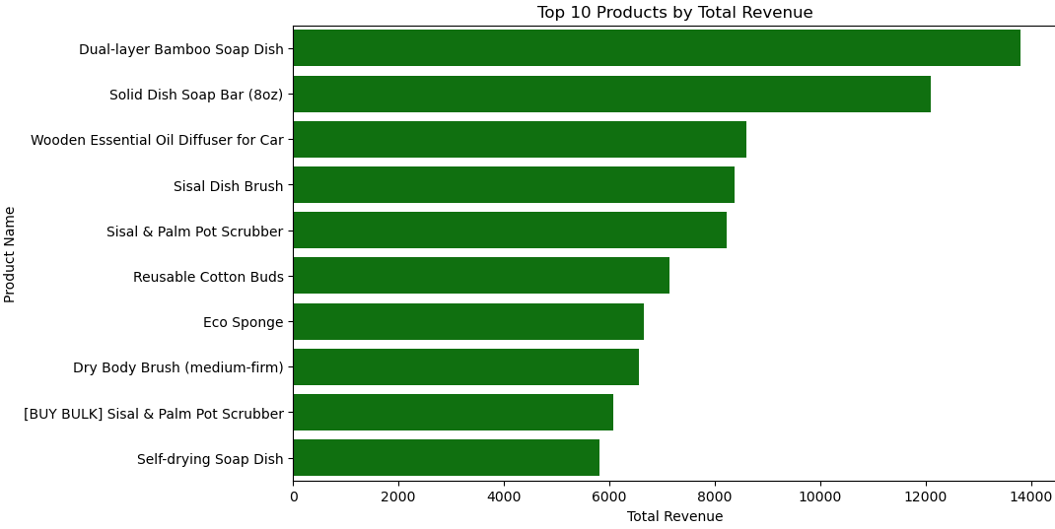
2
Top products
The top 10 products according to our excel files is :
1. Dual-layer Bamboo Soap Dish
2. Solid Dish Soap Bar (8oz)
3. Wooden Essential Oil Diffuser for Car
4. Sisal Dish Brush
5. Sisal & Palm Pot Scrubber
6. Reusable Cotton Buds
7. Eco Sponge
8. Dry Body Brush (medium-firm)
9. [BUY BULK] Sisal & Palm Pot Scrubber
10. Self-drying Soap Dish

Slide 7
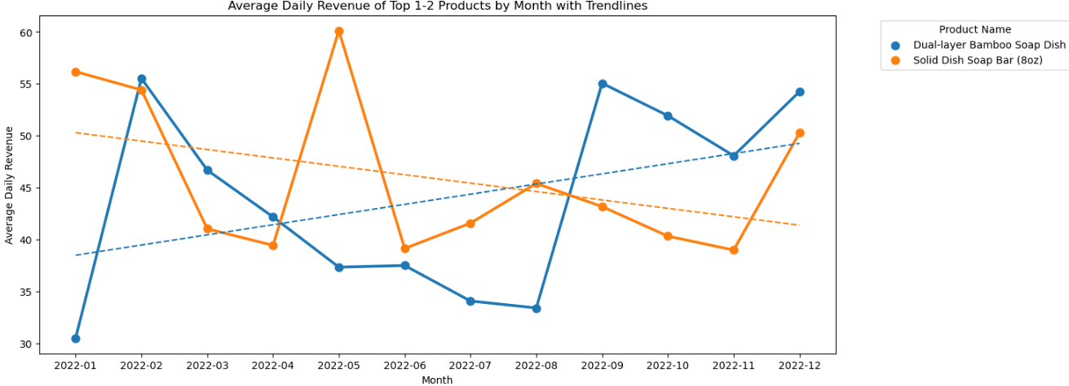
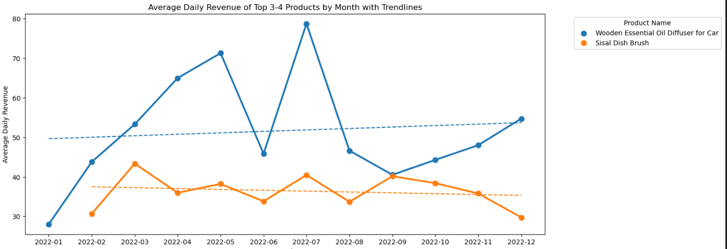
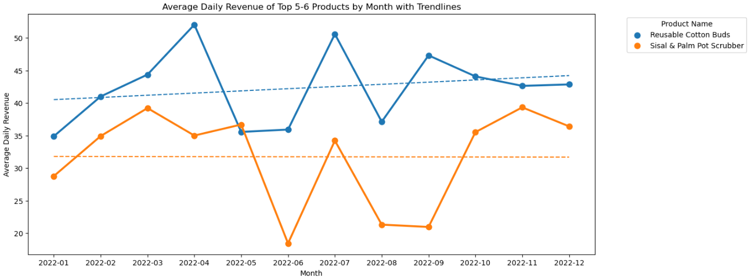
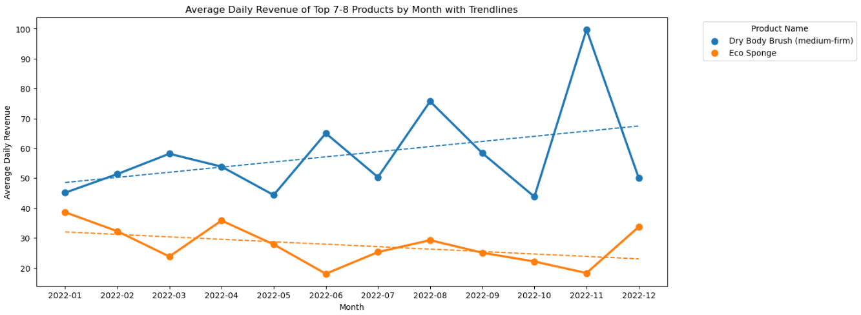
Top Products : Graphs
Note : Only sales data from 2022 were available.
Bad news : The growth has not been reaching goals of doubling revenue.
Good News : There is still a trending increase for most products. Next slides are actions I recommend to increase growth

Slide 8
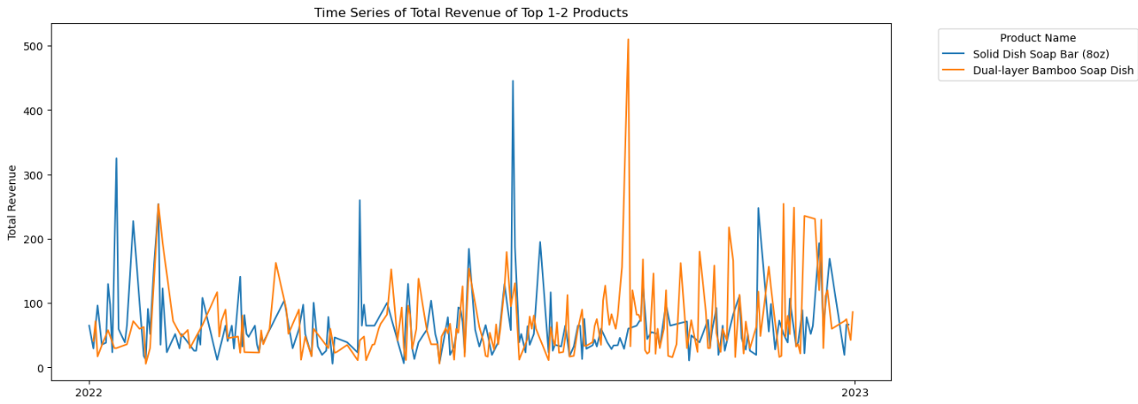
Top Products : Further Analysis
Recommendations to increase sales of top products :
One way to increase sales for the top products is to have a best sellers list somewhere in the website.
Increase the amount of sales and advertise sales through cheap means, maybe through tiktok, reddit and blogposts. When I plotted daily revenue of the top 10 products, I noticed spikes. This might have been caused by a successful TikTok video.
Give loyal customers an incentive for posting a video on tiktok or youtube. Maybe $1 per 1000 views, or $1 per 10,000 views. This will result in exposure to a bigger audience.
Since these products are heavily purchased, it is a good idea to incentivize reviewing. Give points based on how detailede the review is, via a character limit. This will help Google SEO and in turn, increase sales on the product.

Slide 9
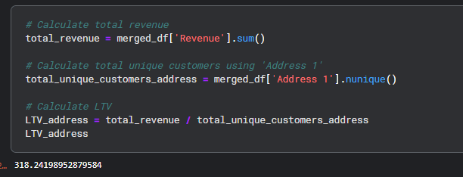
Average customer lifetime value
3
The average customer lifetime value is $316.58. When grouping for each unique ‘Full Address’ value.
Average customer lifetime value can increase with programs that increase customer loyalty. To do this, there are many examples which I will go over next slide :

Slide 10
Ways to Increase Average customer lifetime value
Customer Loyalty program : Based on points, like Air Miles or bubble tea based system where the 7th drink is free.
Scheduled purchases : For daily essentials, there can be scheduled purchases, which can be set by the user. Scheduling purchases can be incentivized by giving a percentage off when you schedule your purchasing. Think Amazon. Subscribe & Save feature.
Sales : There are some customers that only shop during sales, there may be a benefit in having regular sales for christmas, boxing day, back to school days, etc.
Incentivize bulk purchasing : Maybe give free shipping for orders $100 or more, or have a discount for that. Or, have a plantish card for loyal customers, thus they will see it whenever they open their wallet and be reminded of Plantish.

Slide 11
4
How do promos affect sales?
Analytic process :
From the PDF, I manually entered the promo information into an excel file, then through Python, I merged this file with the merged payout and orders data through the date column.
I then separated dates that had a promo available and dates that didn’t have any promotions available.
Through this process I saw a 217% higher cumulative revenue when there was a promo compared to no promo. This wasn’t due to having more days with promo, because, there was 202 days with promos and 163 days without any promos, this results in only 19 percent more days with promo than without.
Note : I only included days in 2022, as sales data was only of 2022.

Slide 12
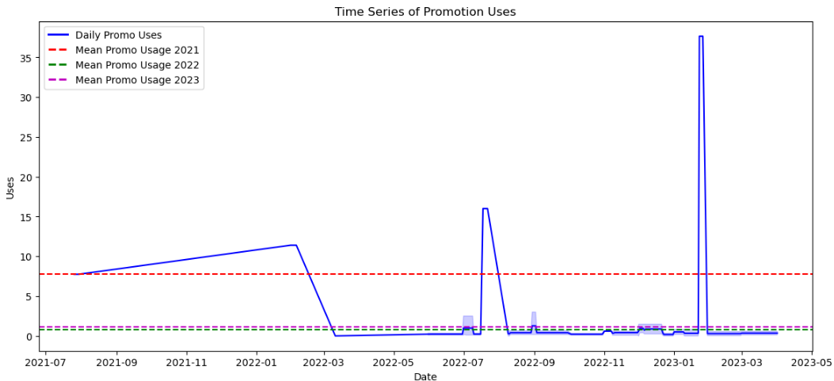
4
Average Promo usage per day
We can see that in 2021, daily promo usage was higher than in 2022 and 2023, Note 2023 is incomplete

Slide 13
Average Promo usage per day
4
We can see that there was 217% more revenue generated when there are promo days. I wondered if the reason for this was because there were more promo days in total, so used Python to check how many days had promo and how many days did not have promo. There were indeed more days that had promo but it was only 19% more days, thus the 217% increase in promo is mostly due to the promos themselves and not the fact that there were more promo days than not.
Also, people typically spend more during holidays and that is usually when promos are held. It is still a good idea to hold promos during the holidays as it gives incentive for users to buy our products instead of products from somewhere else that is also holding promotions.
We can see that promo usage spikes during certain times, probably a great promo or a successful marketing venture (I can see that the wintermarket promos were successful).
What I see that is missing is there are less promos than ideal being used during black friday, or christmas times, as it seems promo usage is just about average during those days. I feel like this is a huge miss in opportunity, because this is when a vast amount of people spend a lot of their hard earned money!

Slide 14
What is the average total order value?
5
Wanted to see how promos affected total order value
The average order value is $162.7
Finding
Visualization 1
How
We got the average of all total order values. (Made sure to drop duplicates)
Visualization 2
Wanted to see average order value for each quarter

Slide 15
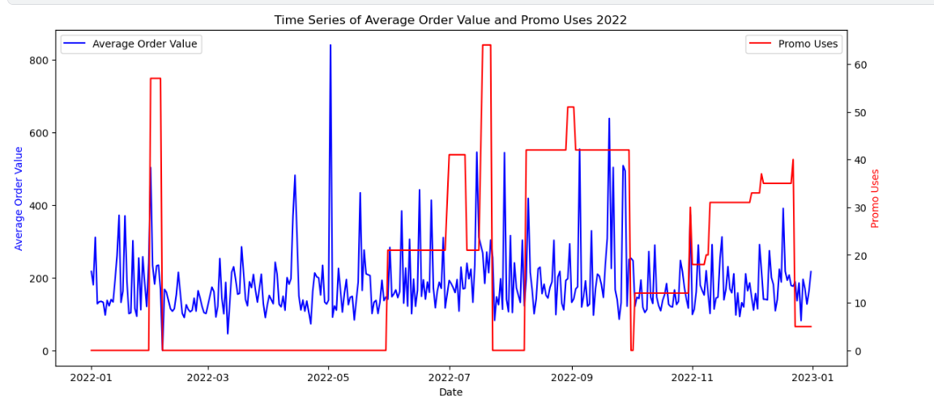
What is the average total order value?
5
Delete duplicate rows, these rows could be due to collection error, skewing data.
To make data easier to work with, and more accurate analysis
Why?
Step 2
Step 1
Step 3
Combine ‘Address 1’ and ‘Address 2’ columns
Create a revenue column, to see how much money each product made

Slide 16
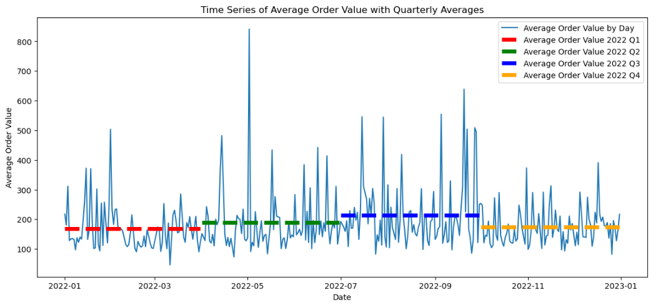
What is the average total order value?
5
Delete duplicate rows, these rows could be due to collection error, skewing data.
To make data easier to work with, and more accurate analysis
Why?
Step 2
Step 1
Step 3
Combine ‘Address 1’ and ‘Address 2’ columns
Create a revenue column, to see how much money each product made

Slide 17
What is the average total order value?
5
To increase he average order value, there are multiple suggestions :
We can add incentives to increase order value -- like a free shipping deal for orders over $100 or give a free item after surpassing $200
We can have combo deals / packs that work with each other. This could add an item that customers otherwise would not have purchased.
More frequent promotions and sales -- Sales can lead to customers buying more products and bulk buying due to lower cost. We can see that promotions used in Q4 is not as high as it should be, as this is when people are most willing to part with their money (Christmas, Hanukkah, new years, etc).
Focus on Q4 sales , like bulk buying as this is when people spend their money. It seems that Q4 has low average order value because people are buying a gift for their friend, so maybe we can incentivize a larger order as people usually spend their money in Q4.

Slide 18
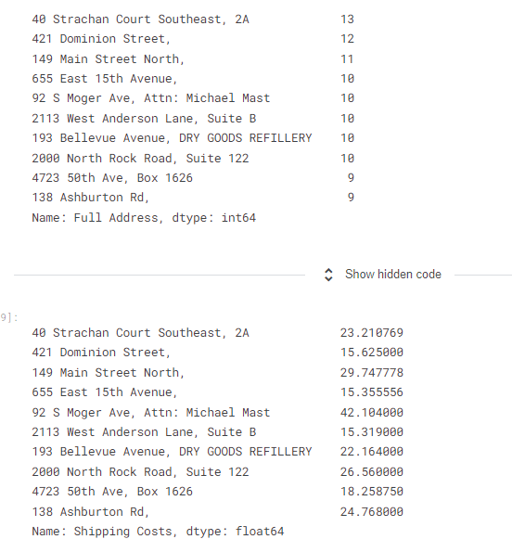
Common shipping locations
6
The top 10 shipping locations are :
40 Strachan Court Southeast
421 Dominion Street
149 Main Street North
655 East 15th Avenue
92 S Moger Ave
2113 West Anderson Lane
193 Bellevue Avenue
2000 North Rock Road
4723 50th Ave
138 Ashburton Rd

Slide 19
Common shipping locations
6
The average shipping cost of all orders is $22.64, and 5 out of 10 of the top shipping locations have higher shipping costs than the average. Therefore, shipping costs do not affect the top 10 shipping locations as much.
Although, it could still be better and having warehouses closer to some of the top shipping locations, particularly 92 S Moger Ave, who pays $42.1 per shipping order would be benefitial. This is because a farther shipping location would mean a higher shipping cost.
Also, it could benefit the company to ship to or partner with known retailers, big or small. The more people adopting a zero – or low waste lifestyle, the better. Plus we get exposed to a larger audience.

Slide 20
Inventory Management and reducing costs
7
Time series on cost per day
Total Cost of all damaged or missing goods is $9448.08
Total Cost
Visualization 1
Average
Our data range for inventory was 316 days. Thus, average cost per day for damage or missing items is $29.9
Visualization 2
Cumulative cost over the year 2022

Slide 21
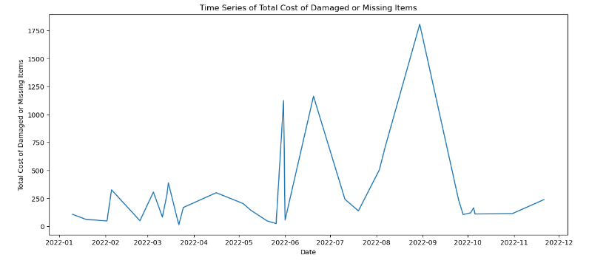
Inventory Management and reducing costs
7

Slide 22
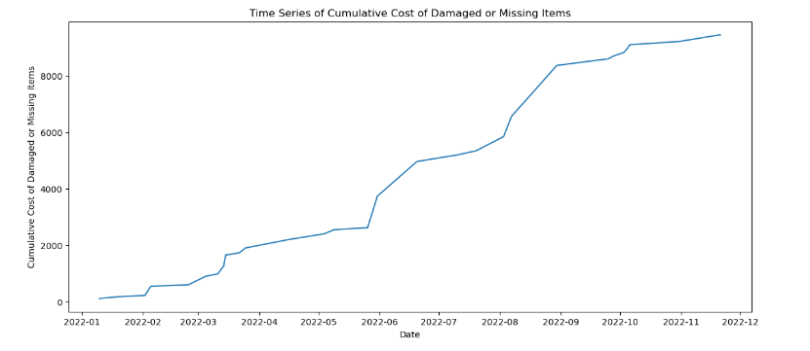
Inventory Management and reducing costs
7

Slide 23
Inventory Management and reducing costs
7
I found that the on average, the company loses $29.9 due to damaged or missing products with a total of $9448.08 lost due to missing or damaged items.
This is assuming that the range of 316 days that damaged was tracked is consistent with the days where damage was not tracked.
We can see that most of the money lost due to missing or damaged items are caused by huge spikes. This may be because that is when inventory was checked to be missing or it could be due to a large shipping incident that had caused a large amount of inventory to be damaged.

Slide 24
Suggestions for inventory management
7
More than one warehouse, maybe an east and west warehouse. This is so the shipping distance is less per order. This could decrease shipping cost and also, less travel means less chance of damaged product.
Inventory audits : More regular counting of material or sorting / organization could lead to less inventory going missing.
Inventory tracking : Use inventory management software to track inventory levels in real-time, which can help prevent shortages and excesses.
Many products get damaged during shipping due to inadequate or improper packaging. Investing in better packaging materials and techniques can reduce the damage rate.
Use sales data and analytics to forecast future demand for products. This can help you keep the right amount of stock on hand and avoid overstocking or understocking.

Slide 25
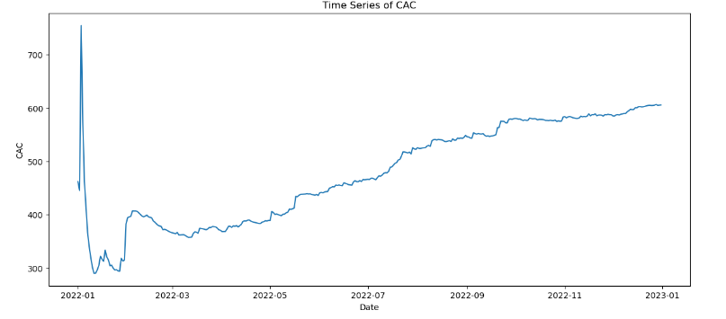
Average customer acquisition cost
8
The average CAC is $38.67 and is steadily increasing.
This could be due to the number of customers growing.

Slide 26
Average customer acquisition cost
8
To reduce CAC, we can decrease the commission fee of 25%
for new customers and instead, put that money towards forms of advertisements, like more TikTok videos or increasing the budget we have to give customers incentive to review our products on TikTok or our review page.
This way, we can acquire customers in a more organic way.

Slide 27
9
Extra Research -> Revenue
I personally feel like the metric for growth is total revenue. If total revenue is increasing per day that is a good sign! Let's check if that's the case in the next slide

Slide 28
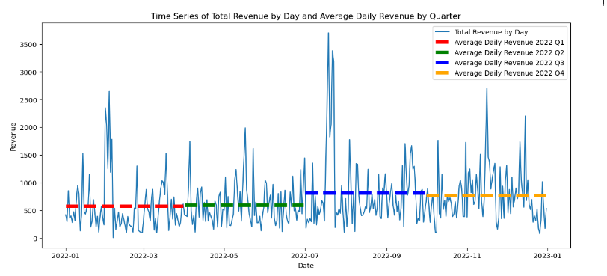
9
Extra Research -> Revenue

Slide 29
9
Extra Research -> Revenue
Unfortunately we only have data for the sales of 2022. So it is hard to gauge growth. Although, in 2022 it does seem like there was a growth of total revenue per quarter. This is good news, and is not as apparent if we only look at the time series of daily sales (Which is very squiggly.)
The bad news is, Q4 should be a very good quarter as it is when people like to spend their money, like during Christmas, Black Friday, etc.
The good news is that we can step our game up and focus on increasing marketing efforts, sales and other strategies to perform better in Q4, untapped potential means potential means to get money and spread the word on zero-waste products!

